Slide 1
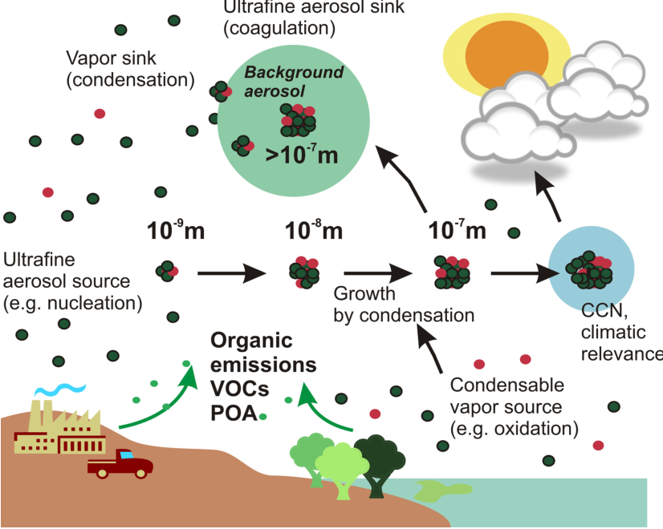
Aerosol Phase Atmospheric Chemistry
More aged, larger size, higher oxidation state
ATM 505
Spring 2023
Jie Zhang Lecture 4
VOC: volatile organic compounds

Slide 2

Introduction and Fundamentals
Atmospheric Particulate Matter(PM)/Aerosols
Definition: An aerosol is a relatively stable suspension of fine solid or liquid particles in air.
Aerosol = Particles = Particulate Matter (PM)
PM_{x}: particles with diameters smaller than x mm (e.g., PM₁, PM_{2.5}, PM₁₀)
PM range in diameters from ~0.002 to 100 μm (2 – 100,000 nm) and may be in a solid or liquid state. (Gas --- Aerosol --- Fog or Cloud Droplet)
An aerosol can be envisioned as a population of particles consisting of “k” molecules or monomers.

Slide 3
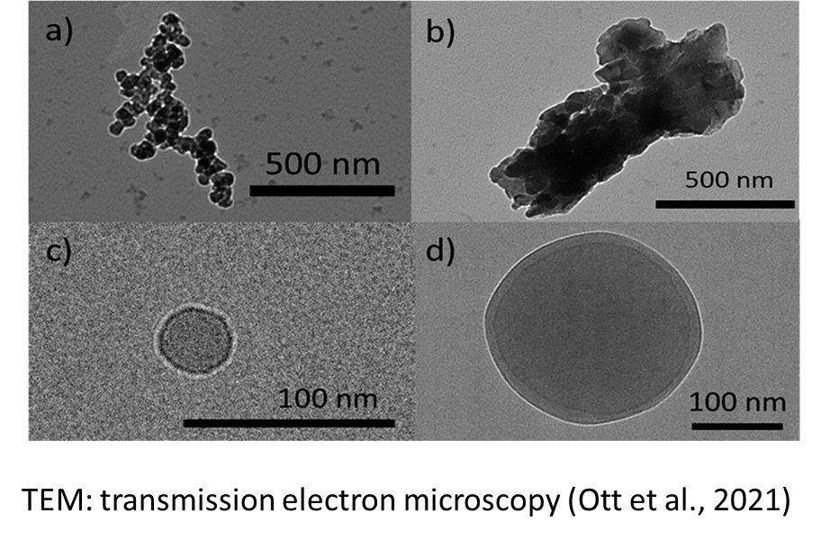
Aerosol properties
For ambient aerosol, what do we generally measure?
What do we want from these measurements
Simply assumed to be a sphere
Mass concentration (µg m⁻³)
Aerosol source
number concentration (# m⁻³)
Formation pathway
Size distribution
Aerosol evolution
Chemical compounds
Response to emission control
Other…
Others

Slide 4
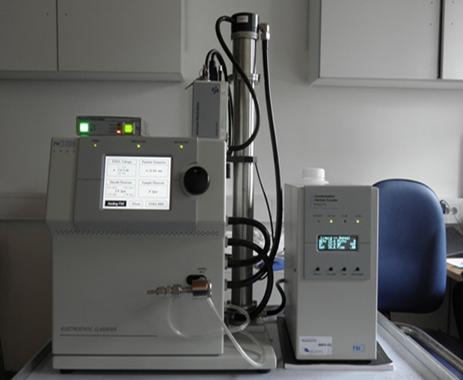
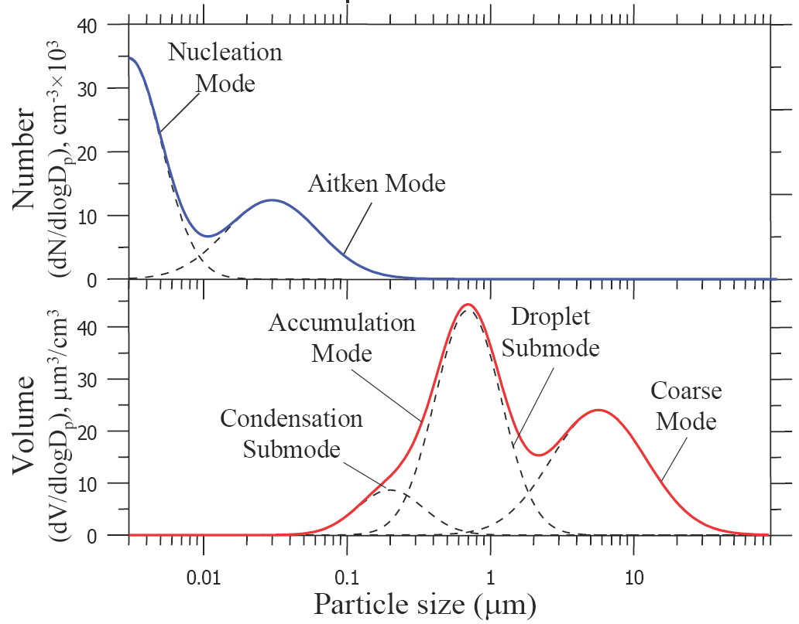
Aerosol properties: size
Size Classifications of Ambient Aerosols: Modes
Fine PM (PM_{2.5})
Coarse PM
Nucleation mode:
< 0.01 μm
Ultrafine mode:
< 0.1 μm
Accumulation mode:
0.1 – 2.5 μm
Fine mode:
< 2.5 μm
Coarse mode:
> 2.5 μm (sometimes 2.5 to 10 µm)
Ultrafine PM
Scanning Mobility Particle Sizer (SMPS): consists of an Electrostatic Classifier (EC, model 3080), a Differential Mobility Analyzer (DMA, model 3081), and a Condensation Particle Counter (CPC, model 3785) : measures aerosol size distribution.
Particle diameters (μm)
2003 NARSTO Assessment
Notes:
4
We will not look at the coarse mode

Slide 5
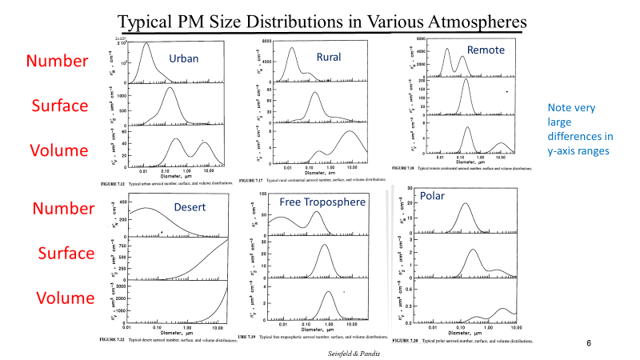
Aerosol properties: size

Slide 6
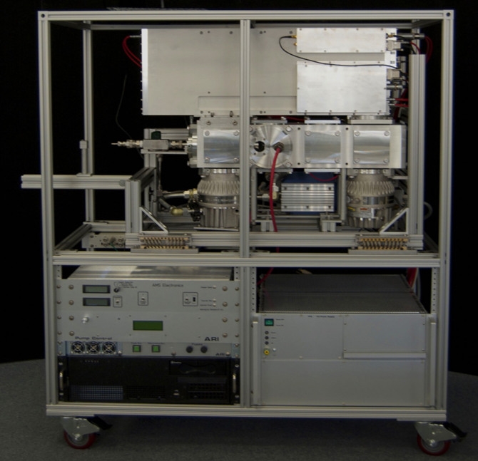
Aerosol properties: Chemical Components
Note: AMS has detected size range from around 100nm-1500nm; each instrument has its limitation
OA: Organic
SO4: sulfate
NO3: nitrate
NH4: ammonium
High-Resolution time-of-flight Aerosol Mass Spectrometer (HR-ToF-AMS): measures non-refractory (NR) submicron aerosol (NR-PM1) compositions
Cl: chloride
Others

Slide 7
Aerosol properties: Chemical Components
Organic aerosol comprised a major fraction (18–70%; average =45%) of the non-refractory submicron particle mass at the various locations (Figure 1), while sulfate (10–67%; avg = 32%), nitrate (1.2–28%; avg = 10%), ammonium(6.9–19%; avg = 13%) and chloride (<D.L.-4.8%; avg = 0.6%) made up the other major components. (note: 2007!!!)
Zhang et al., GRL, 2007

Slide 8
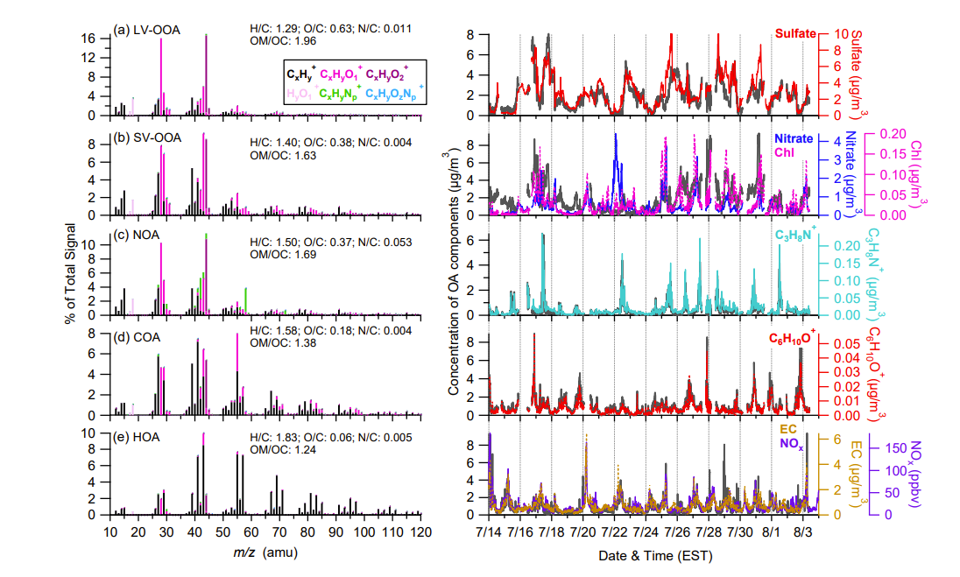
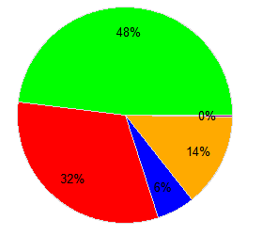
Aerosol properties: Chemical Components
Organic
PMF
SO₄
NH4
NO3
PMF (Positive Matrix Factorization)-used to separate OA into different factors,
MO-OOA: More oxidized oxygenated organic aerosol (heatwave, firework, fog);
LO-OOA: Less oxidized oxygenated organic aerosol (heatwave, firework, fog), “fresher” than MO-OOA;
HOA: hydrocarbon-like OA (heatwave, firework), often related to traffic emission;
BSOA: Biogenic secondary organic aerosol (fog), formed through biogenic VOC reaction;
FW-OOA: firework-related oxygenated organic aerosol (firework);
COA: cooking-related OA (firework study)

Slide 9

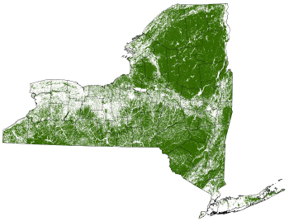

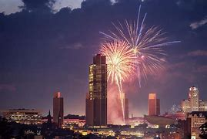
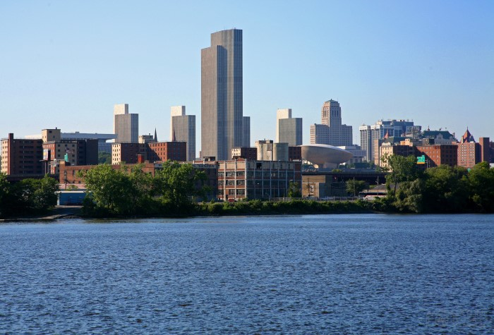
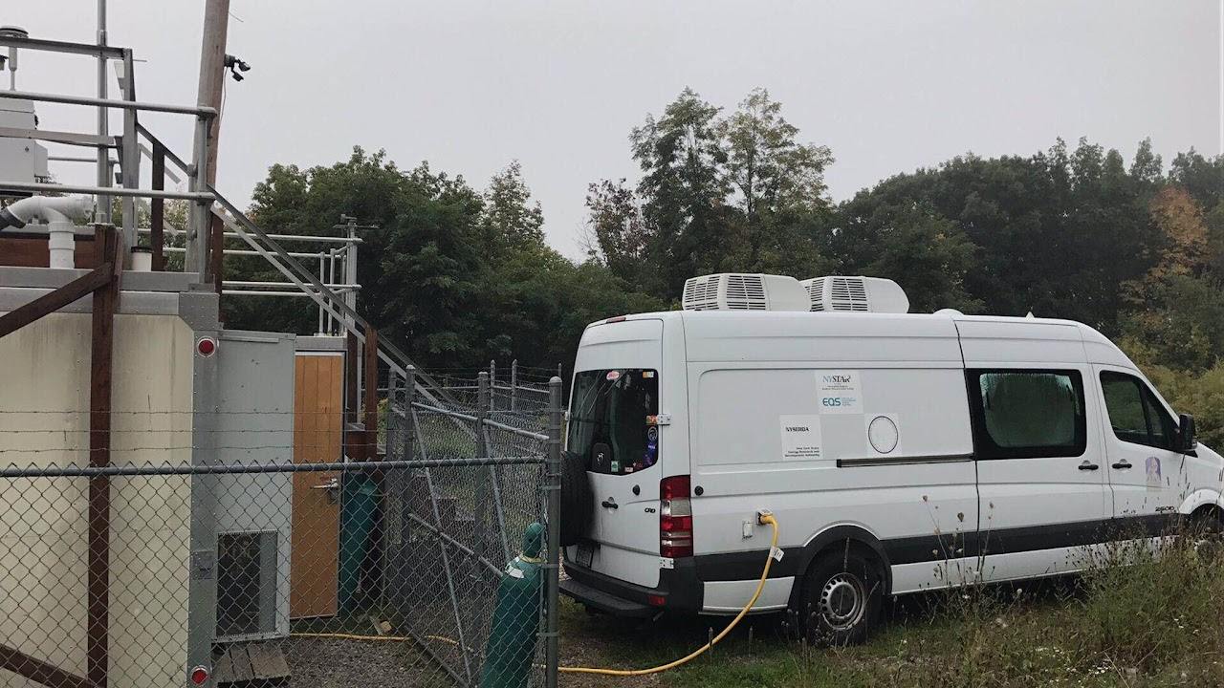
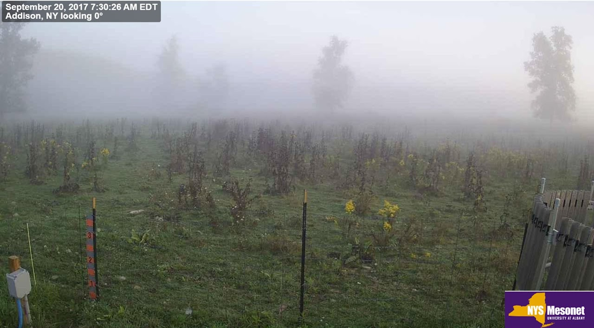
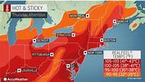
Aerosol evolution under different conditions
Mountain cloud
Urban firework
Forest fog
Urban heatwave

Slide 10
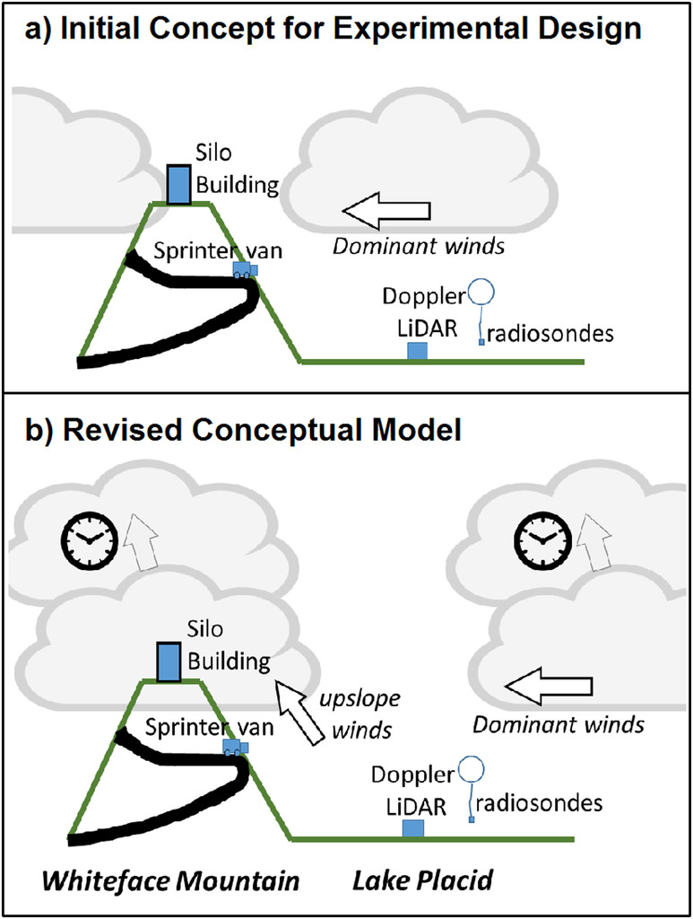
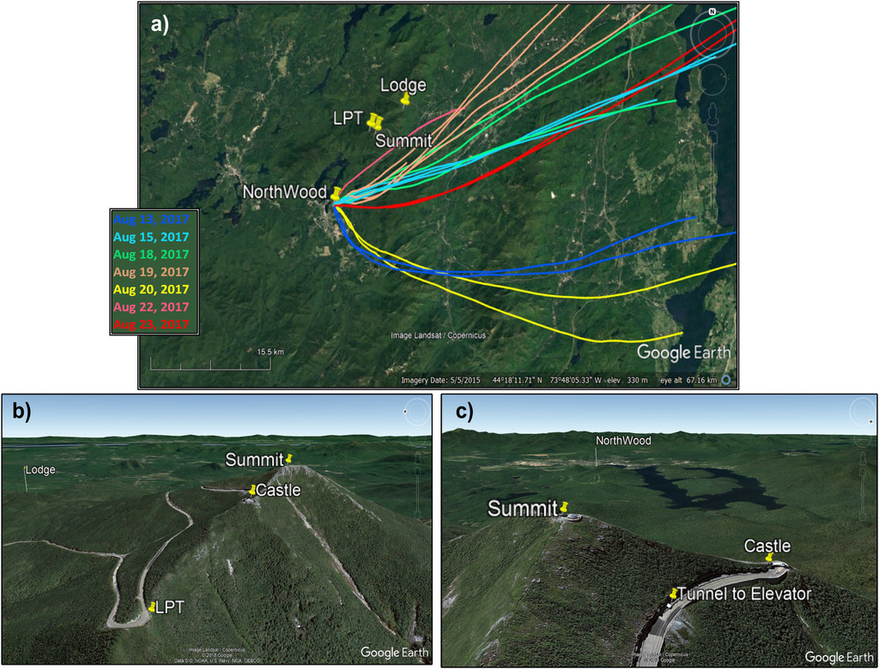
1. Aerosol evolution under cloud conditions
Sometimes the designed concept is not accurate!

Slide 11
1. Aerosol evolution under cloud conditions
August 15, 18, 19, 21, and 22 were classified as days influenced by urban sources (air mass passed Great Lake area), with 66-78% for organic, and 15-24% for SO₄;
August 17, 20, and 23, defined as biogenic influence periods (air mass from Canada forest), with 85-93% for organic and 4-10% for SO₄;
Four In-cloud measurements
No PMF analysis, due to limited dataset

Slide 12


1. Aerosol evolution under cloud conditions
Three cloud layers were identified for the four In-Cloud days;
Enhanced NO₃ concentration in the Transition layer, which could be formed following the uptake of nitric acid, which was subsequently neutralized by ammonium under saturated high-RH conditions;
The organic and SO₄ mass concentrations were similar for TL and BL;
Finally, the aerosol total mass and number concentration decreased significantly to only 10% and 52%.
Question: why number and mass are different?
Large particles are easier absorbed/activated to the cloud!!!

Slide 13
2. Aerosol evolution under fog conditions

Slide 14
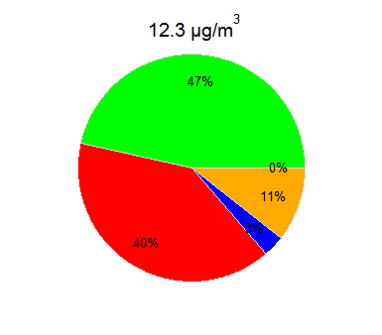
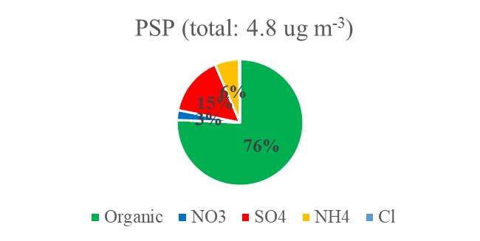
2. Aerosol evolution under fog conditions
During the measurement period, the dry aerosol PM₁ mass concentration at PSP was 1.04-7.09 μg m⁻³ with an averaged value of 4.32 μg m⁻³;
Organics was the main component of PM₁, with an average mass fraction of about 76%;
Three fog nights were observed.
How to verify it was a fog night?
2004
2017
Mesonet Camera
Vs.

Slide 15
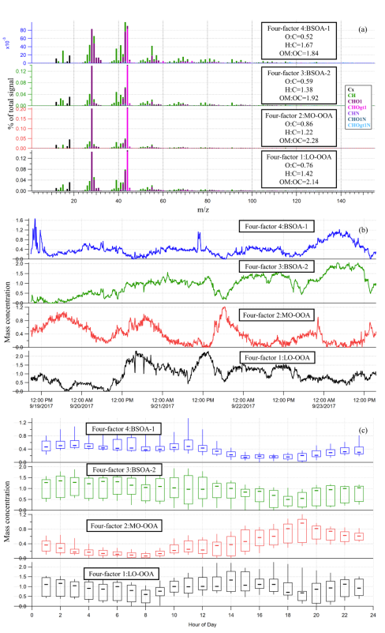
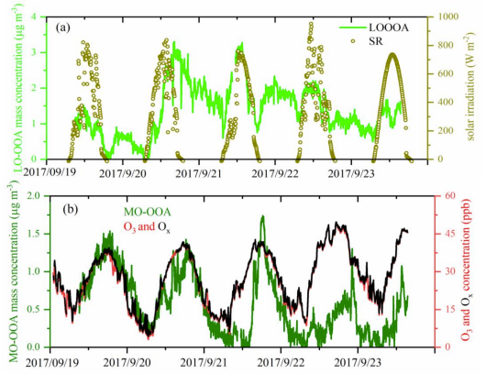
2. Aerosol evolution under fog conditions
PMF results:
Excepts the profile of the mass spectrum, we normally need to another evidence to verify the reasonability of each factor/species?
Relationship with other compounds, i.e., sharing similar formation pathway. Think about your own research.
How about BSOAs? Why name it BSOA? Any relationship with other species/factors?

Slide 16
2. Aerosol evolution under fog conditions
Biogenic SOA shows similar behavioral trends to aerosol organic nitrates (pNO3,org) as well as HNO3
The organic nitrate was averaged 67% of total nitrates
Nocturnal NO3 (Nitrate radical)+BVOC reaction could be an important formation pathway

Slide 17
2. Aerosol evolution under fog conditions
Based on the transition points of the aerosol compounds, as well as RH and solar irradiation variations, the entire fog life cycle was divided into five fog processing periods namely:
fog_before_forming (F-B),
fog_forming (F-F),
fog_scavenging (F-S),
fog_dissipating (F-D)
fog_post_dissipating (F-P).

Slide 18

2. Aerosol evolution under fog conditions
MO-OOA showed the highest solubility and scavenging efficiency (86%), followed by LOOOA (55%), SO₄ (53%), and BSOA (25%);
Comparing to the initial period (F-B), the F-P aerosols mass slightly increased about 7% to 15% for the first three nights with an averaged value of 11%, and the O:C ratios decreased while the H:C ratios increased;
That is likely related to the decrease of MO-OOA and the enhancement of LO-OOA+BSOA.
Question: internal mixed or external mixed? Which compound will have a largest size?
External, more oxidized MO-OOA has larger size/more aged; BSOA is small and new formed
$$\text{SE}\text{=}\frac{{\text{C}}_{\text{F}\text{−}\text{B}}\text{−}{\text{C}}_{\text{F}\text{−}\text{S}}}{{\text{C}}_{\text{F}\text{−}\text{B}}}$$
Scavenging Efficiency:

Slide 19
2. Aerosol evolution under fog conditions
When RH was below 96%, but with RH increasing, BSOA mass concentrations increased in combination with the enhanced RH;
The slopes of these four nights are 0.9-2.6 with an averaged value of 1.9, which means during this study that an increase of 0.1 in the ALW ratio would average lead to an increase of about 0.2 μg m⁻³ BSOA.
Question: Why?

Slide 20
2. Aerosol evolution under fog conditions
The increased RH (or ALW):
provides more medium for gas-soluble species to dissolve and also reduces the viscosity and increases the diffusivity of the quasi-aqueous organic reactant molecules, increasing the aerosol bulk reaction rate to produce more BSOA,
and/or reduces the viscosity and increases the diffusivity of small size BSOA aerosol or related organic matter (such as highly oxygenated organic molecules [HOMs]), which would be more easily or quickly dissolved into ALW and mixed with other inorganic/organic components and enhance the particle mass/size growth, which in turn are measured by the HR-ToF-AMS

Slide 21
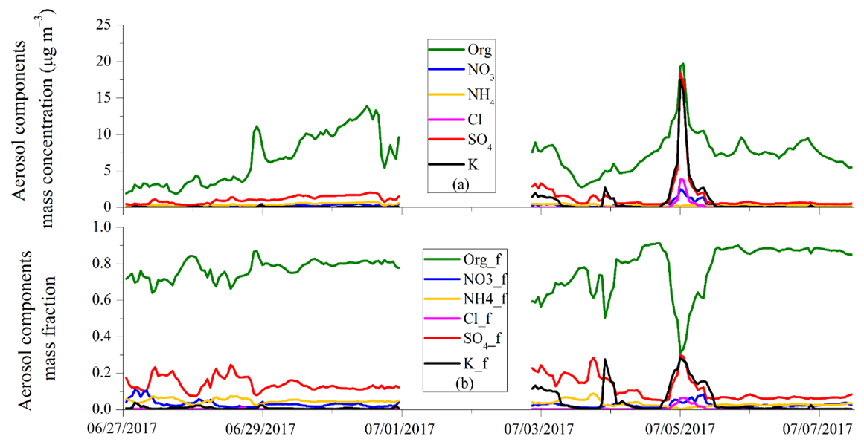
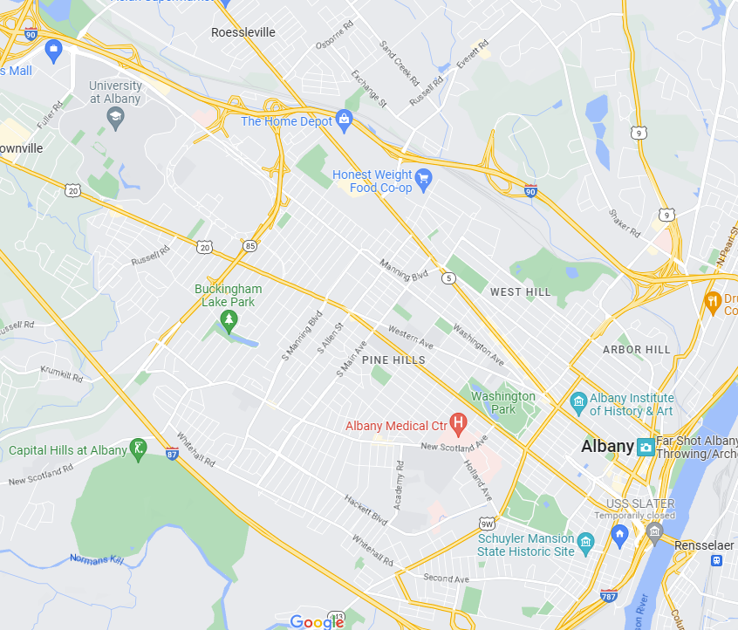

3. Aerosol from firework
The highest Potassium (K) concentration occurred on the night of July 4;
The observed concentrations of K were as high as 17.4 μg m^{–3} (July 5 00:00 EDT), which is about 350 times the background value

Slide 22
3. Aerosol from firework
The averaged mass concentrations of total aerosol, organics, K, SO₄, NO₃, and Cl were all clearly elevated compared to earlier that day (July 4 9:00 to 17:00 EDT), increasing by factors of 6.5 (total), 2.7 (organics), 248 (K), 21 (SO₄), 20 (NO₃), and 280 (Cl)

Slide 23
3. Aerosol from firework
SMPS data
AMS data: external mixed
The most of Independence Day FW PM₁ aerosols measured were in the size range of 50 to 250 nm with mass size distribution in the range of 200–500 nm; (recall the different number vs. mass distribution)
Different mode diameters for the different chemical components indicate a nonuniform mixing state for organics and inorganics, suggesting different sources of freshly emitted aerosols associated with FW displays.

Slide 24
3. Aerosol from firework
Sources Apportionment:
Local background ((NH₄)₂SO₄, NH₄O₃, OOA) concentration contributed about 13% of total PM during the FW significantly influenced period;
Traffic emissions and cooking contributed a relatively small amount, about 10%, of the total PM;
The biggest contribution came from FW burning, as inorganic K-containing compounds and FW-OOA comprised 77% of the total (36.3 of 47.0 μg m^{–3}), and among them inorganic K-containing species contributed 63% and FW-OOA another 14%.
Question: which one is primary aerosol? Which is second aerosol?
Question: Possible source for FW-OOA?
FW-OOA was also likely mixed with the aerosol produced by the burning of binding agents, such as dextrin, or the shell paper.

Slide 25
3. Aerosol from firework
During the late evening on Independence Day (July 4 21:00–23:00 EDT), the wind in the lower levels of the atmosphere (below 500 m) was weak and variable, mainly due to the dominant high pressure over New York State;
High CNR values at the lowest measurement levels occurred above the ASRC sampling site on July 4 23:20.
The firework emissions, which occurred in an environment with a nearly stable nocturnal boundary layer, resulted in high aerosol mass concentrations over the Albany area for several hours, lasting through the night.

Slide 26
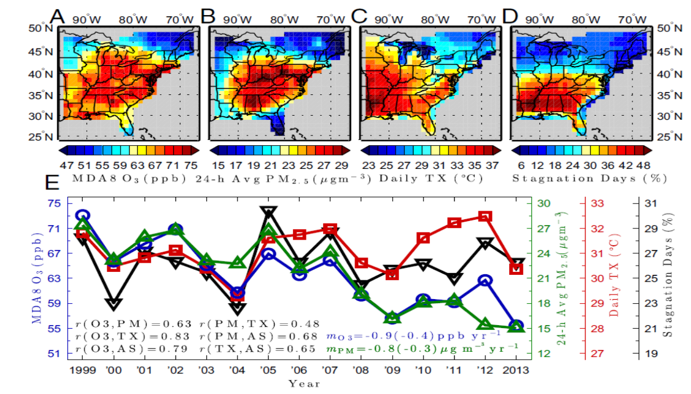
4. Aerosol evolution under heatwave
Persistently high temperature conditions most commonly happen under stagnant conditions with weak surface winds (below 3.2 m s−1) and little or no precipitation (below 1 mm).
Stagnant conditions, in conjunction with strong solar insolation, lead to
an increased photochemical reaction rate between volatile organic compounds (VOCs) and oxidants like the hydroxyl radical (OH),
increased emissions and
the accumulation of anthropogenic nitrogen oxides (NOx), anthropogenic and biogenic VOC precursors,
Thus, leading to an increased production of O3 and secondary organic aerosol (SOA)
Schnell et al., PNAS, 2017
Co-occurrence of extremes in surface ozone, particulate matter, and temperature over eastern North America, which can synergistically worsen their health impacts beyond the sum of their individual effects.
Any thoughts for the reasons?

Slide 27
4. Aerosol evolution under heatwave
BP1: Background Period - southerly winds and low aerosol mass concentration;
EPG: Enhanced Period – Growth - aerosol mass increasing and northerly winds (low WS);
EPM: Enhanced Period – Mature - aerosol mass relatively stable with low and variable winds;
EPD: Enhanced Period – Decline - aerosol mass dropped quickly;
BP2: Background Period - Slightly stronger winds shifting south to north, low aerosol mass.
EPM
EPG
EPD
BP1
BP2
Why to sperate into different periods?
Each period for different processing.

Slide 28
4. Aerosol evolution under heatwave
BP1: lowest aerosol mass with highest SO₄ mass fraction (about 27%);
BP1 to EPG then to EPM: the aerosol total mass, organic mass and SO₄ mass concentrations keep increasing, and particles increase in size.
EPG: LO-OOA largest fraction; EPM: MO-OOA largest fraction.
EPD: Large size aerosol particles quickly clear out.
Aerosol growth

Slide 29
4. Aerosol evolution under heatwave
High correlation coefficient between LO-OOA and anthropogenic VOCs (methanol, acetone, acetaldehyde, toluene, acetone, and benzene);
O₃ and anthropogenic VOCs also behaved similarly during heat wave period;
Periods of high isoprene during late afternoon (max 40ppb), but no sign of significant IEPOX-SOA from AMS
Colored by Temperature
Others’ founding maybe not work for you!!
27

Slide 30
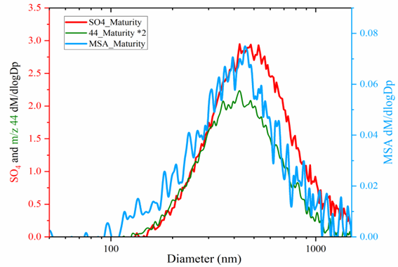
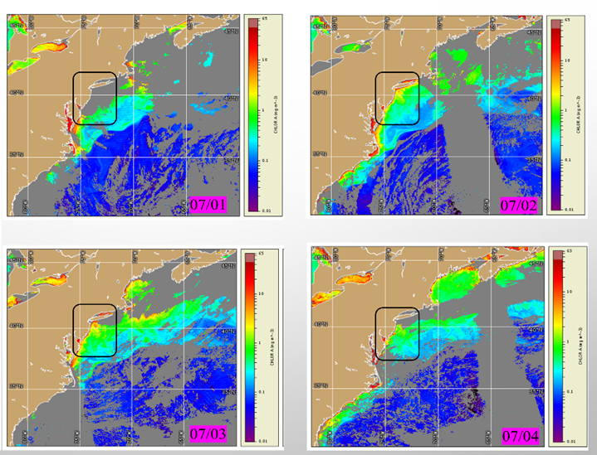
4. Aerosol evolution under heatwave
MO-OOA correlated well with sulfate (an R² of 0.68) and with MSA (an R² of 0.71);
The contribution from the DMS related SO₄ to the total SO₄ was estimated to be about 37%.
MO-OOA, MSA and SO4 were largely internal mixed during EPM.
Note: DMS from phytoplankton activity
New source for SO4
MSA: methanesulfonic acid DMS: dimethylsulfide

Slide 31
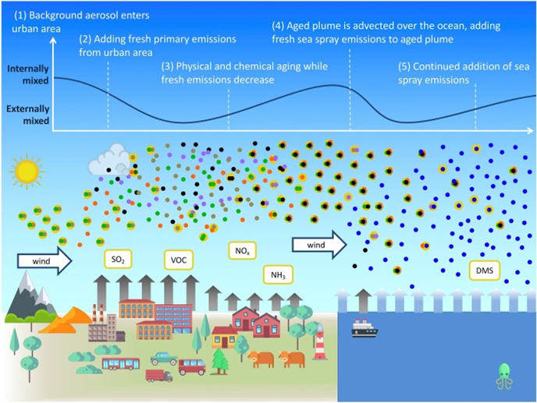
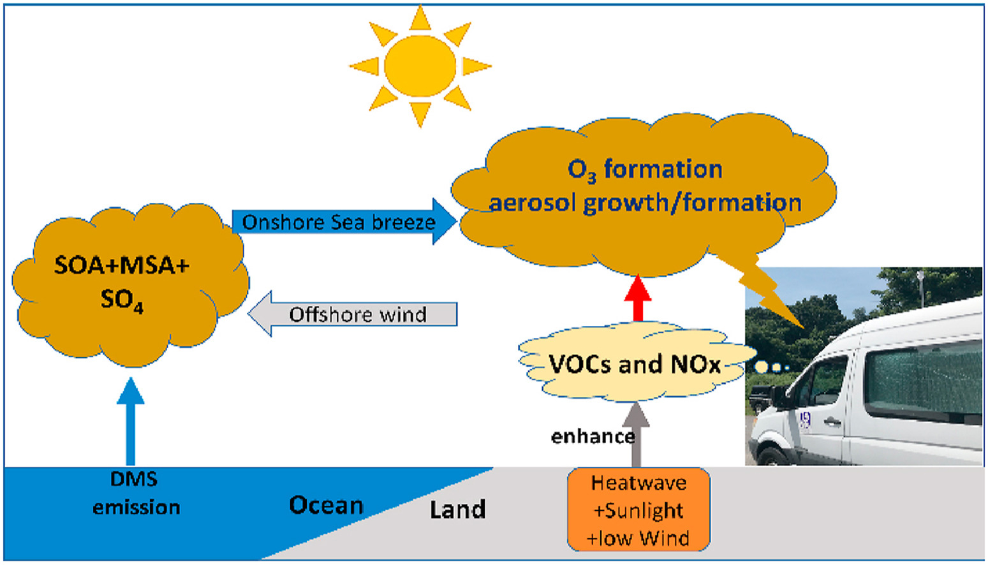
4. Aerosol evolution under heatwave
Sea breeze
Fromm google
This study

Slide 32
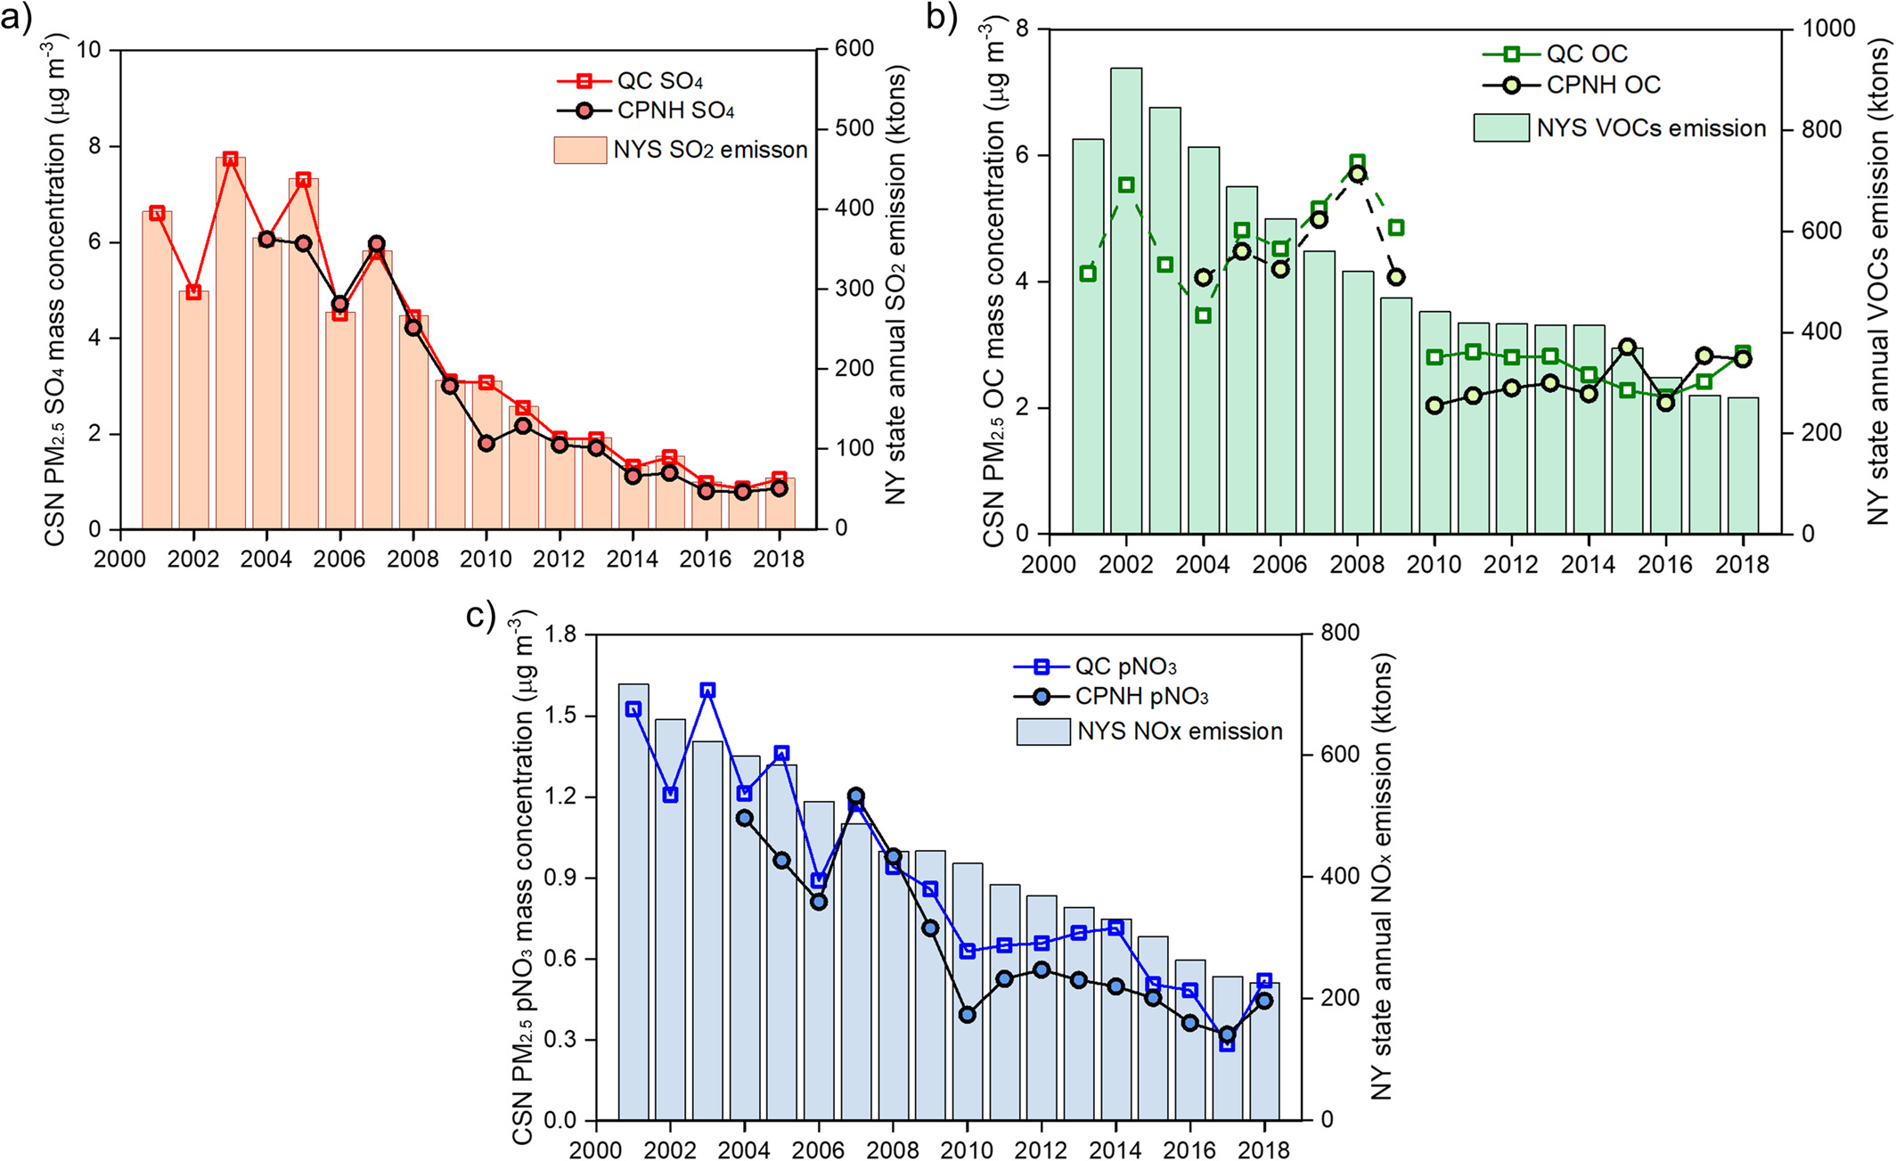
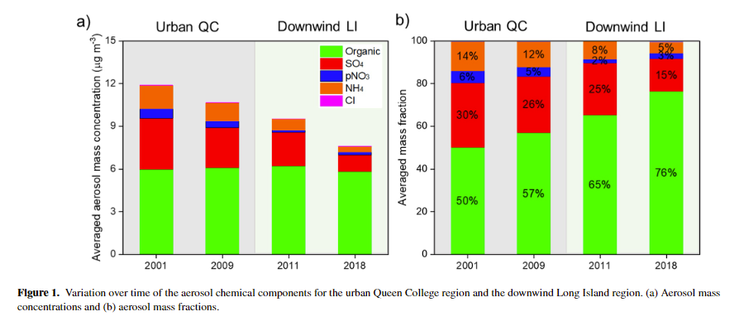
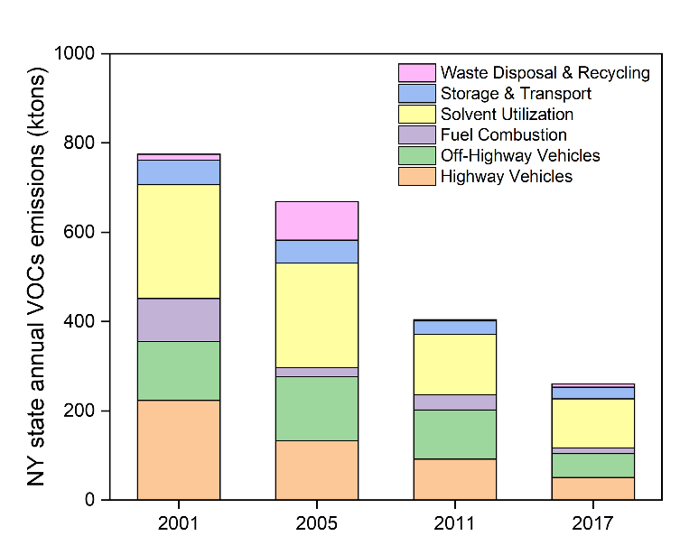
5. Response of aerosol to emission controls
Dramatic decrease in the inorganics (mainly SO4, NH4, and pNO3), while there was little change for organics.
Data from Chemical Speciation Network
？

Slide 33
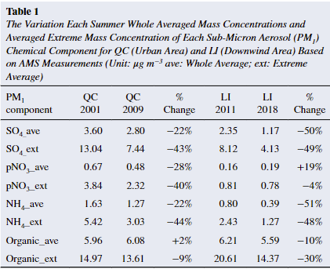
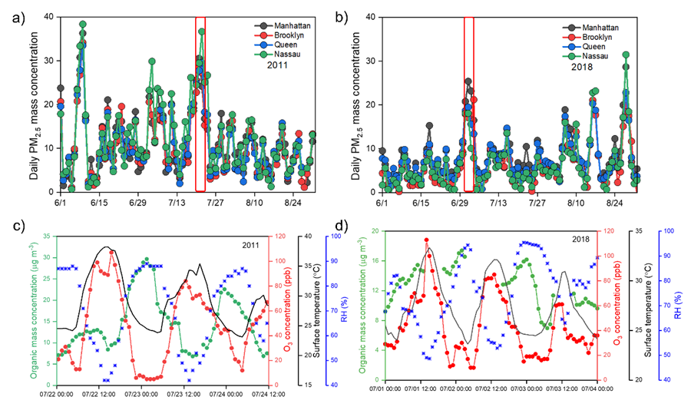
5. Response of aerosol to emission controls
The organic extreme value reduced 30% for Long Island, much more significant than averaged value.
Organic extreme value happened during night under high RH
Recall the fog event, what maybe the formation pathway for these nighttime organic extreme?

Slide 34
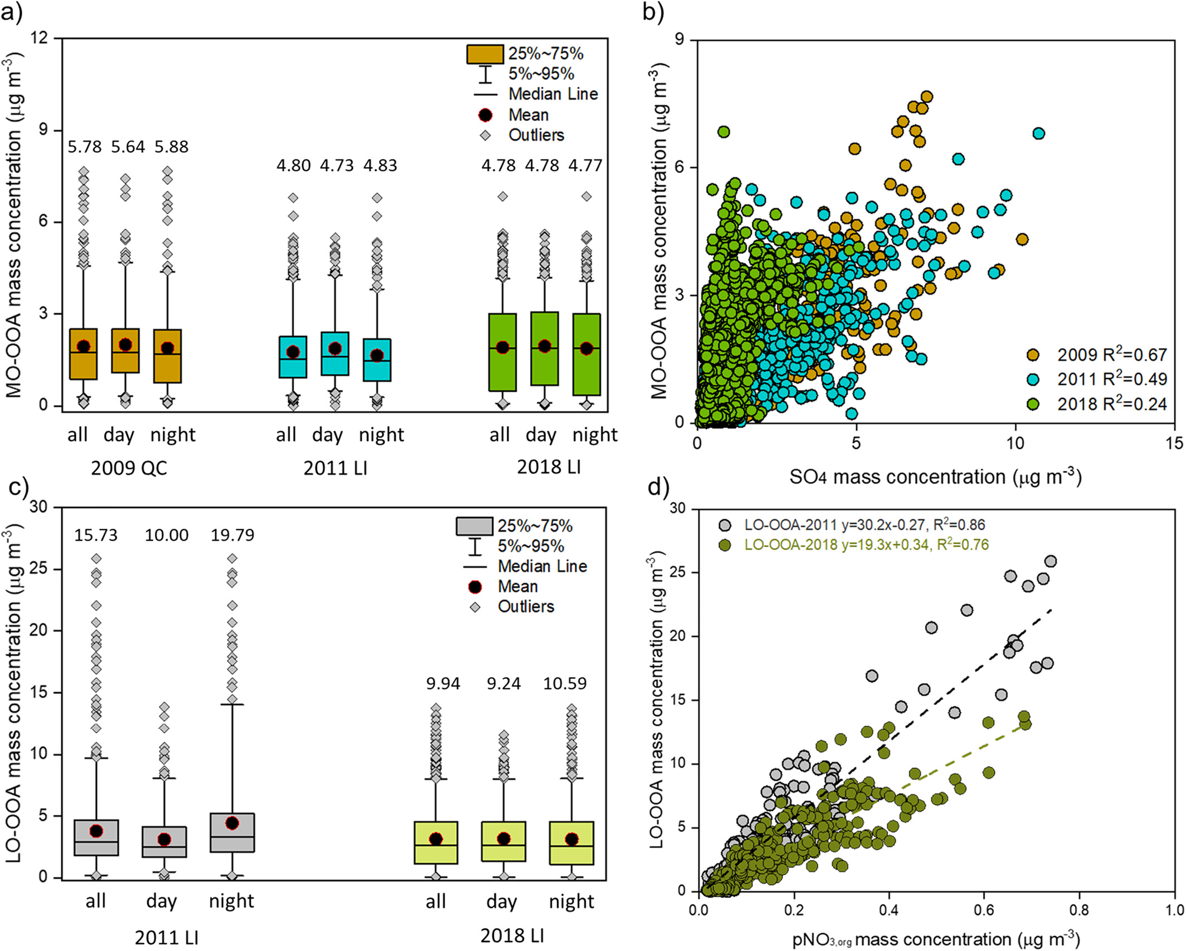
5. Response of aerosol to emission controls
Local formed secondary organic aerosols (SOA) nighttime extremes reflect the reduction of anthropogenic volatile organic compounds
A flat multiyear trend is observed for the regional-aged SOA
The regional aged SOA is becoming increasingly decoupled from highly oxidized particle sulfate

Slide 35
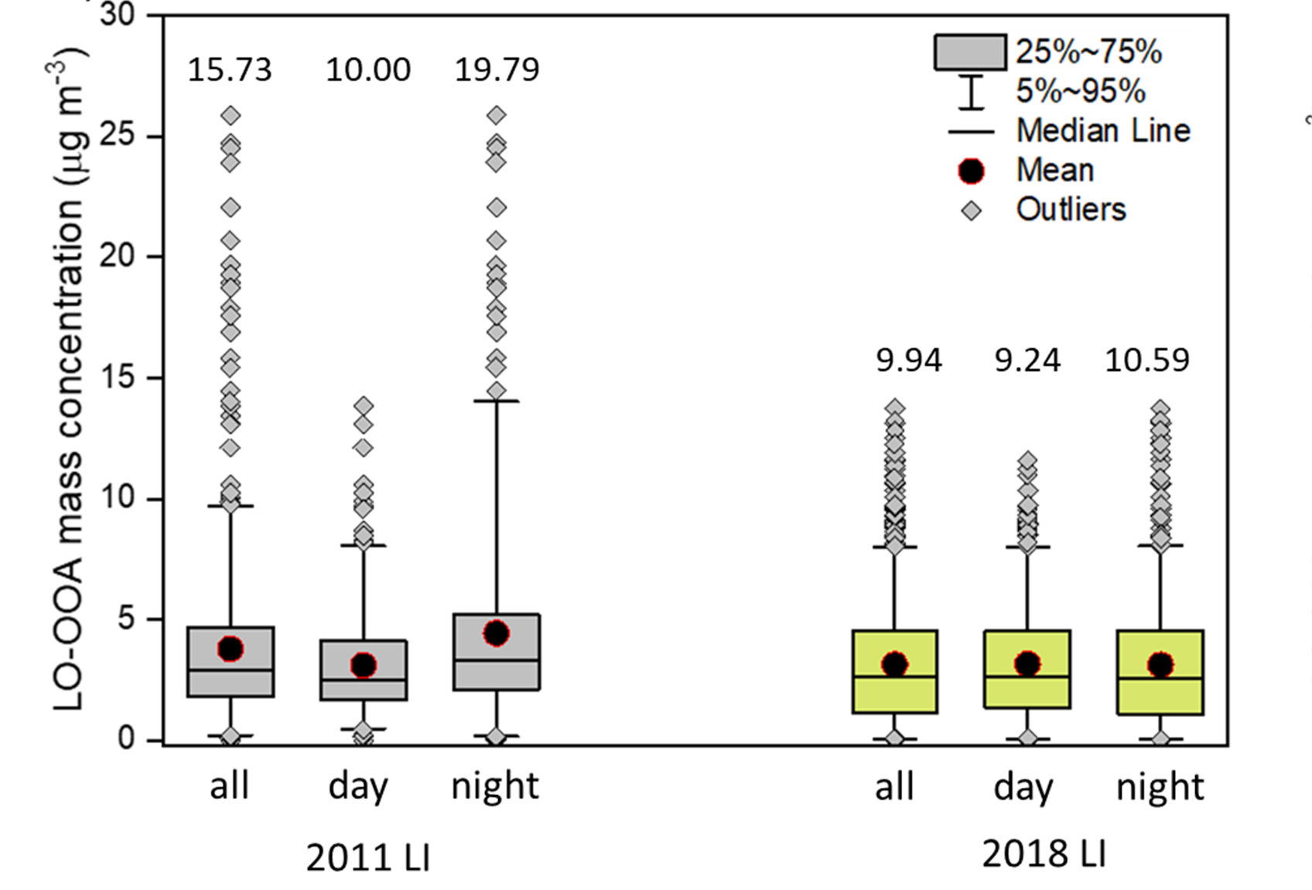
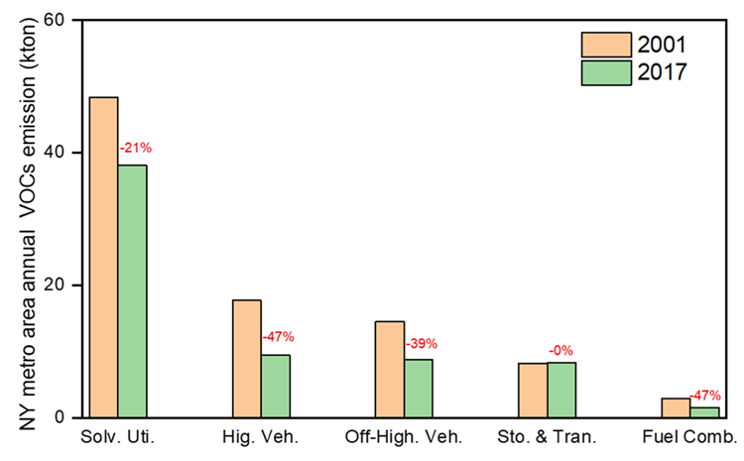
5. Response of aerosol to emission controls
LO-OOA nighttime extreme reduced about 46%, matched the VOC emission reduction from vehicles, and fuel combustion;
LO-OOA daytime extreme no clear variation trends, indicating different formation pathways for the nighttime extreme. (maybe VCP as its precursors.)

